Slide 1






Powerplays and Predictions: Unlocking IPL Intelligence - Data Visualization using Pandas data frame
Ashwin Shastry Paturi, Akarsh Lakshmana, Divakar Reddy Ravi, Sara Verkiyani
Team 09 - CS506 02 IN - Spring 2025 Computer Science
School of Technology & Computing (STC)

Slide 2
Agenda
Introduction
Approach
Dataset Overview
Pandas Concepts
Summary of Key Insights
Learning Outcomes
Q&A

Slide 3
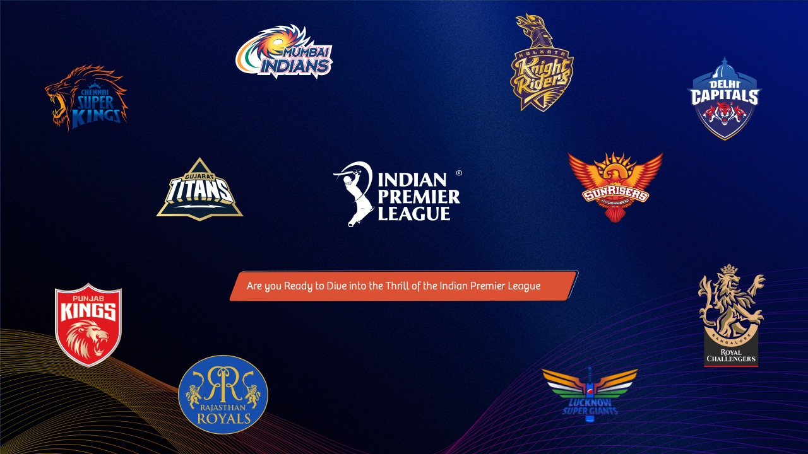
Dataset Overview
Dataset: A single dataset containing comprehensive IPL match-level data (all_season_summary.csv)
Columns include team names, toss details, scores, captains, key players, venue, and umpires.
The dataset used includes match-level information from multiple IPL seasons. It contains over 70 columns and includes data on:
Team-level info: home team, away team, scores, captains, playing Xis
Match outcome info: winner, toss decision, result type, player of the match
Time and venue: start/end dates, venue name, umpires
Scoring metrics: runs, wickets, boundaries
Metadata: result descriptions, match days, super over info
Notes:
These steps ensured clean, structured data ready for meaningful analysis.

Slide 4

Pandas Concepts
DataFrame operations: Data cleaning, column creation
apply(): Custom logic for extracting result types
groupby(): Aggregation by team and result type
assign(): Chaining transformations for win margins
value_counts(): Frequency of result types
merge() (optional) - Joining datasets if extending with player/team stats
datetime handling: Calculating match duration using start and end dates
Notes:
These steps ensured clean, structured data ready for meaningful analysis.

Slide 5
Data Visualization – Tools and Techniques
Chart Type Insight Provided
Barplot Match result type distribution (runs, wickets, tie, etc.)
Histogram Duration of matches in days
Horizontal Barplot Top 10 highest win margins by team (runs/wickets)
Horizontal Barplot Average win margin per team for runs vs wickets
All plots are built using Seaborn with consistent styling for clarity.

Slide 6
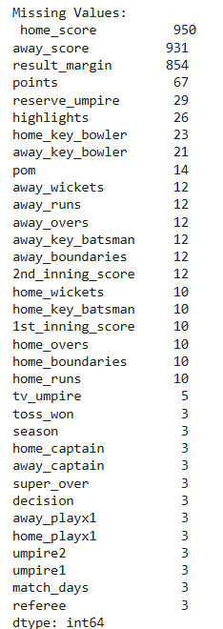
Dataset Cleaning
Visualized missing values to understand which columns are incomplete, and proceeded to clean the data by:
Dropping rows where the winner is missing (as they are critical to most analyses).
Converting date and score columns to appropriate formats.
Engineering a new column to calculate the margin of victory.
Pandas Concepts: shape, columns, isnull(), dropna(), .copy(), to_datetime(), to_numeric() - DataFrame filtering, transformation, visualization with Seaborn
Notes:
These steps ensured clean, structured data ready for meaningful analysis.

Slide 7
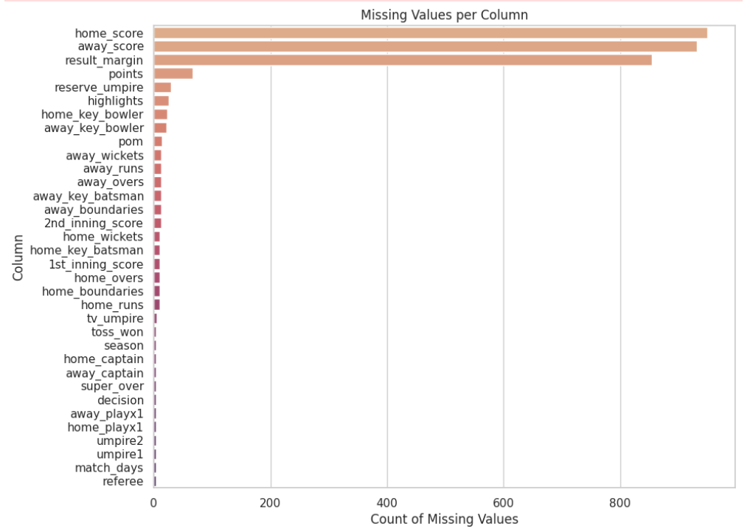
Feature Engineering & Validation
Added result_margin column (score difference)
Verified dataset shape post-cleaning
Clean, consistent data ready for insights
Improved data quality for visualization
Notes:
These steps ensured clean, structured data ready for meaningful analysis.

Slide 8
Summary of Key Insights
Runs vs Wickets: Most IPL matches are won by wickets, emphasizing the value of chasing in T20 cricket.
Dominant Teams: Teams like MI and CSK consistently show higher win margins.
Toss Analysis: Teams that win the toss and choose to field often win the match, an avenue for ML analysis in later modules.
Match Duration: While most matches are one-day events, a few span multiple days, hinting at delays or complex scheduling.

Slide 9
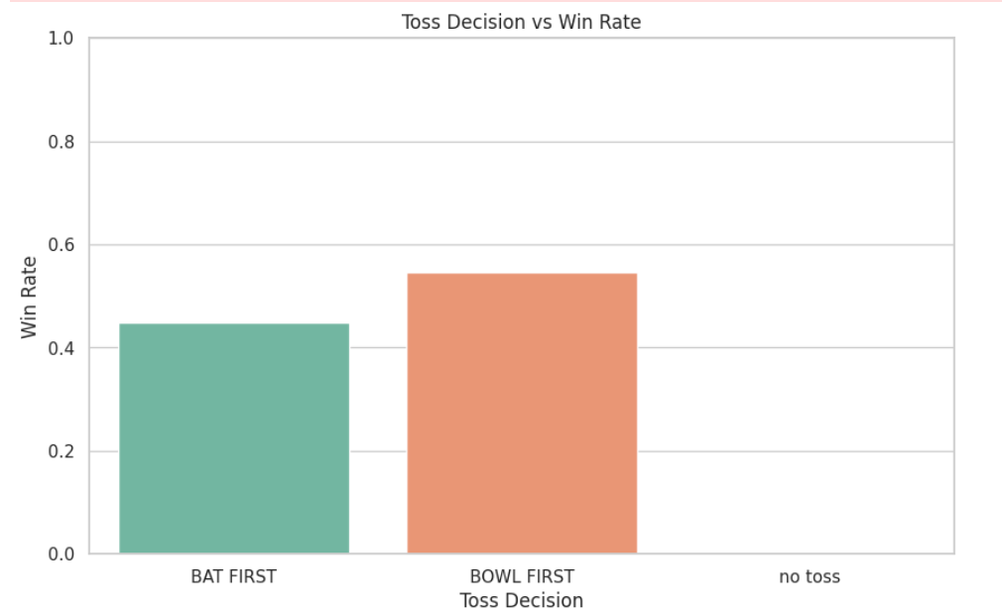
Toss Decision Impact on Match Outcome
• The toss plays a crucial strategic role in IPL matches.
• Data shows teams that choose to bowl first after winning the toss have a higher win percentage.
• This advantage is likely due to better performance while chasing a target, where teams can pace their innings more effectively.
• Environmental factors such as dew during the second innings and pitch behavior under lights further influence outcomes in favor of the bowling-first decision.
• This insight helps teams fine-tune their decision-making based on match timing and venue.
Teams winning the toss and choosing to bowl first tend to have a higher win percentage. Bowling first has statistically shown a competitive edge, especially under specific pitch and weather conditions.

Slide 10
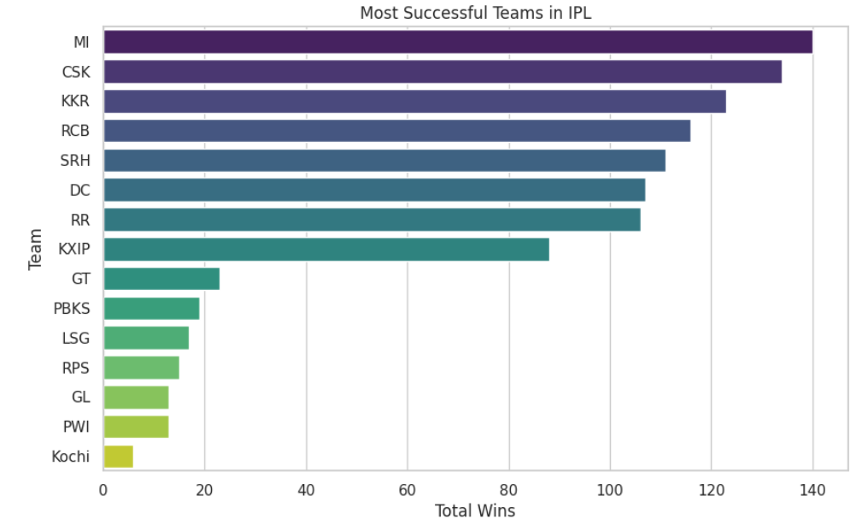
Team Performance Over Seasons
Teams like Mumbai Indians (MI) and Chennai Super Kings (CSK) consistently top the win charts across multiple seasons. Their success is driven by:
Strong leadership (e.g., MS Dhoni, Rohit Sharma),
Stable core player base,
Data-driven match strategies.
Teams with inconsistent performances often suffer from frequent squad changes or a lack of strategic planning.
Visual trends highlight sustained excellence by seasoned franchises and challenges that newer teams face.
This analysis emphasizes the value of continuity and cohesive team culture.
Strategic team management and player retention have proven crucial over time.
Notes:
These steps ensured clean, structured data ready for meaningful analysis.

Slide 11
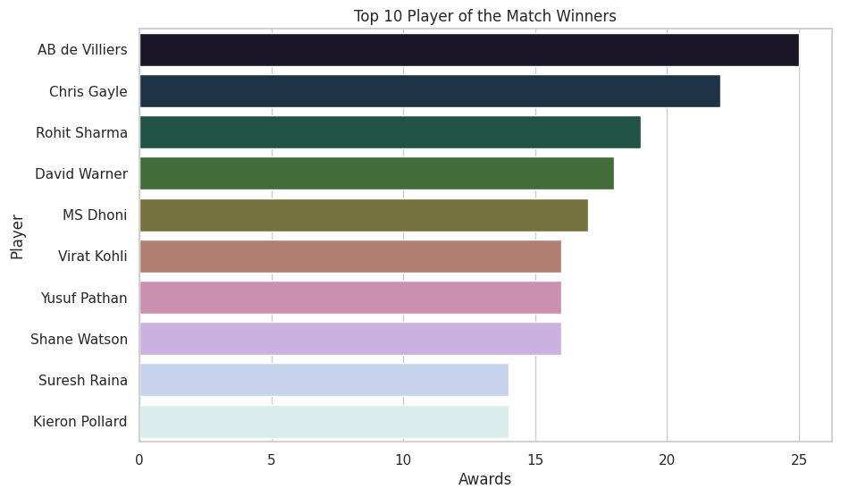
Player of the Match (POM) Trends
Trends Observed - Batsmen are more likely to win POM than bowlers. Batting performances tend to receive more recognition for match-defining contributions.
Analysis of Player of the Match awards shows that batsmen dominate in the frequency of recognition.
Match-defining high scores tend to draw attention, especially under pressure or in successful chases.
While bowlers contribute significantly, their efforts are more recognized in low-scoring thrillers or with standout stats (e.g., 4+ wickets).
This trend reflects a bias in perception favoring batting performances in high-visibility roles.
The insight can help teams and players position themselves better for awards and visibility.
Notes:
Grouping and aggregation allowed us to identify team strategies and dominant play styles.

Slide 12
Reference
What is pandas? (n.d.). https://geo-python-site.readthedocs.io/en/latest/lessons/L5/pandas-overview.html
McKinney, W. (2017). Python for Data Analysis: Data Wrangling with Pandas, NumPy, and IPython (2nd ed.). O'Reilly Media.
IPL T20 | Indian Premier League Official Website. (n.d.). https://www.iplt20.com/
Indian Premier League (IPL) - All seasons. (2024, May 13). Kaggle. https://www.kaggle.com/datasets/rajsengo/indian-premier-league-ipl-all-seasons
Using Matplotlib — Matplotlib 3.10.1 documentation. (n.d.). https://matplotlib.org/stable/users/index.html
pandas documentation — pandas 2.2.3 documentation. (n.d.). https://pandas.pydata.org/docs/
Seaborn: statistical data visualization — seaborn 0.13.2 documentation. (n.d.). https://seaborn.pydata.org/
Notes:
Grouping and aggregation allowed us to identify team strategies and dominant play styles.

Slide 13


Q&A

